Slide 1
Classification of Potential Buyers
Presented By: Sai Sathvick Chirakala, Maitreyi Naik, Nikhila Ratakonda
Instructor: Dr. Fang Jin

Slide 2
Part 1: Data Preprocessing
Importing the Dataset
Splitting the Dataset into Training Set and Test Set
Feature Scaling {normalize the range}
Data Preprocessing Template

Slide 3
Part 2 - Classification
Classification is the process of predicting the class of given data points. Classes are sometimes called as targets/ labels or categories. Classification predictive modeling is the task of approximating a mapping function (f) from input variables (X) to discrete output variables (y).
Classification belongs to the category of supervised learning where the targets also provided with the input data. There are many applications in classification in many domains such as in credit approval, medical diagnosis, target marketing etc.

Slide 4
Part 2: Classification (Cont’d)
Logistic Regression
K-Nearest Neighbors (K-NN)
Support Vector Machine (SVM)
Kernel SVM
Naive Bayes
Decision Tree Classification
Random Forest Classification

Slide 5
Part 2: Classification Dataset Introduction
The dataset contains information of users in a social network. This information contains the user id, their gender, their age and their estimated salary. This social network has several business clients who can put their ads on the social network. One of their client has a car company which has just launched their brand-new luxury SUV for a great price. And we're trying to see which of these users of the social network are going to buy this newly launched SUV. Depending on the age and estimated income, the built model would predict if the user would purchase it or not.
User ID | Gender | Age | EstimatedSalary | Purchased
15624510 | Male | 19 | 19000 | 0
15810944 | Male | 35 | 20000 | 0
15668575 | Female | 26 | 43000 | 0
15603246 | Female | 27 | 57000 | 0
15804002 | Male | 19 | 76000 | 0
15728773 | Male | 27 | 58000 | 0
15598044 | Female | 27 | 84000 | 0
15694829 | Female | 32 | 150000 | 1
15600575 | Male | 25 | 33000 | 0
15727311 | Female | 35 | 65000 | 0
15570769 | Female | 26 | 80000 | 0
15606274 | Female | 26 | 52000 | 0
15746139 | Male | 20 | 86000 | 0
15704987 | Male | 32 | 18000 | 0

Slide 6
Part 2.1: Logistic Regression
Logistic regression is the appropriate regression analysis to conduct when the dependent variable is dichotomous (binary).
The model builds a regression model to predict the probability that a given data entry belongs to the category numbered as “1”. Just like Linear regression assumes that the data follows a linear function, Logistic regression models the data using the sigmoid function.

Slide 7
Part 2.1: Logistic Regression - Result
﻿Confusion Matrix : [[65, 3],
[ 8, 24]]

Slide 8
Part 2.2: K-Nearest Neighbors (K-NN)
The KNN algorithm assumes that similar things exist in close proximity. In other words, similar things are near to each other.
“Birds of a feather flock together.”

Slide 9
Part 2.2: K-Nearest Neighbors (K-NN) - Result
﻿Confusion Matrix : ﻿[[64, 4],
[ 3, 29]]

Slide 10
Part 2.3: Support Vector Machine (SVM)
The objective of the support vector machine algorithm is to find a hyperplane in an N-dimensional space(N — the number of features) that distinctly classifies the data points.
Support vectors are data points that are closer to the hyperplane and influence the position and orientation of the hyperplane. Using these support vectors, we maximize the margin of the classifier. Deleting the support vectors will change the position of the hyperplane. These are the points that help us build our SVM.

Slide 11
Part 2.3: Support Vector Machine - Result
﻿Confusion Matrix : ﻿[[66, 2],
[ 8, 24]]

Slide 12
Part 2.4: Kernel SVM - Result
﻿Confusion Matrix : ﻿﻿[[64, 4],
[ 3, 29]]

Slide 13
Part 2.5: Naive Bayes
As you might have guessed, this requires us to view things from a probabilistic point of view.
Using this algorithm, we will be dealing with the probability distributions of the variables in the dataset and predicting the probability of the response variable belonging to a particular value, given the the attributes of a new instance.

Slide 14
Part 2.5: Naive Bayes - Result
﻿Confusion Matrix : ﻿﻿﻿[[65, 3],
[ 7, 25]]

Slide 15
Part 2.6: Decision Tree Classification
As the name goes, it uses a tree-like model of decisions. A decision tree is drawn upside down with its root at the top.
Growing a tree involves deciding on which features to choose and what conditions to use for splitting, along with knowing when to stop. As a tree generally grows arbitrarily, you will need to trim it down for it to look beautiful.

Slide 16
Part 2.6: Decision Tree Classification - Result
﻿Confusion Matrix : ﻿﻿﻿﻿[[62, 6],
[ 3, 29]]

Slide 17
Part 2.7: Random Forest Classification
It is an ensemble tree-based learning algorithm. The Random Forest Classifier is a set of decision trees from randomly selected subset of training set. It aggregates the votes from different decision trees to decide the final class of the test object.

Slide 18
Part 2.7: Random Forest Classification - Result
﻿Confusion Matrix : ﻿﻿﻿﻿﻿[[63, 5],
[ 4, 28]]

Slide 19
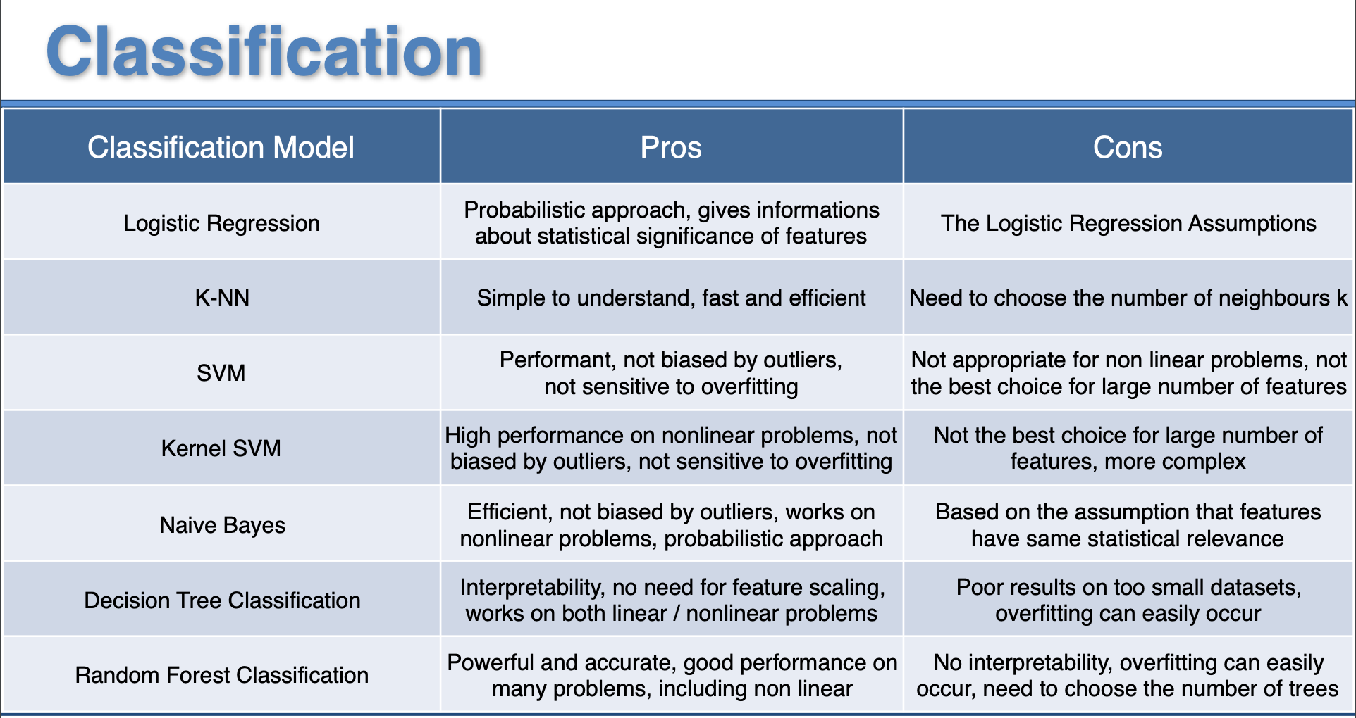

Slide 20
Thank You

